Slide 1
2024
Analyzing Amazon Sales Data
Data Science & Analytics
This project includes the analysis and visualization of the sales datasets using the jupyter notebook & python. It includes the libraries like Numpy, Pandas, Seaborne and Matplotlib.
2024-2025
Unified Mentor

Slide 2
CONTENTS
1
INTRODUCTION
Introduction to the tasks and project.
2
DETAILS OF DATASET
Brief description of the dataset.
3
VISUALIZATIONS
Visualizations using Graphs and Charts.
THANK YOU
4
End Page

Slide 3
PART 01
INTRODUCTION
This Project consists of analyzing the amazon sales data using the any tools and language. The visualization consists of different key factors and KPI’s that helps us to draw different insights and stories.
Data Science

Slide 4
PART 02
DETAILS OF DATASET’S
The dataset is freely available in the Kaggle and its consists of different types, products, prices, location, quantities sold etc.
Data Science

Slide 5
INFO ABOUT DATA:-
We can able to visualize the data using the different rows and columns that will be fulfilled our requirements
Region
Units Sold
Channels
Items
It shows in which region our product selling is more
How many units sold?
The product reached to the customer in a online or offline medium
What is the type of items sold to the customers.
Safety Production Responsibility

Slide 6
PART 03
VISUALIZATION’S
Data Science

Slide 7
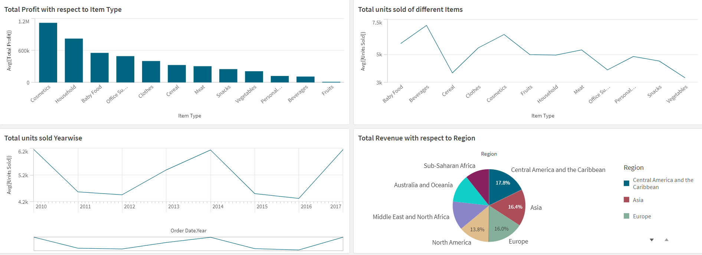
VISUALIZATIONS:-

Slide 8
THANK YOU
Unified Mentor
Data Science

